Slide 1
Mobile Computing
Xii Sem BTI
Syllabus, course policy and subject discussion

Slide 2
Contents
Syllabus
Teaching Scheme
ICA Evaluation
Reference Books
Subject Overview

Slide 3
Syllabus

Slide 4
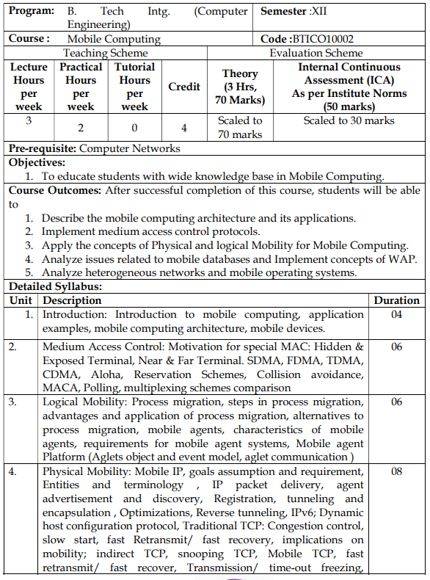
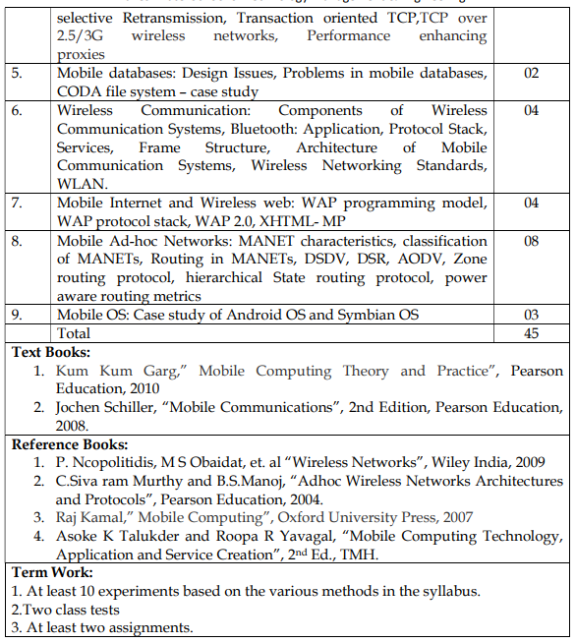

Slide 5
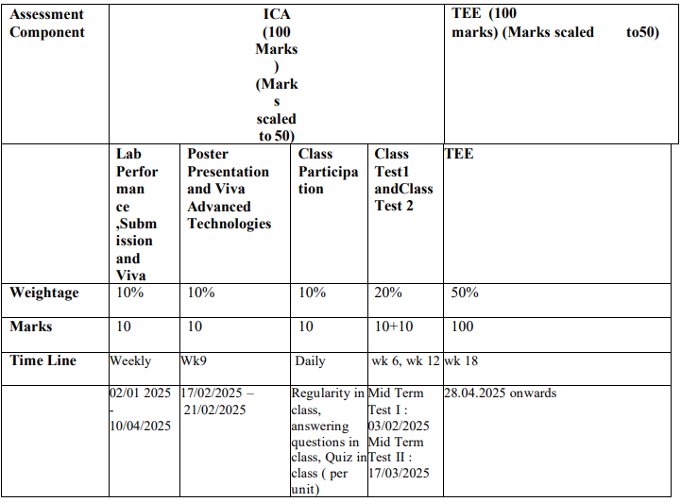
ICA Evaluation

Slide 6
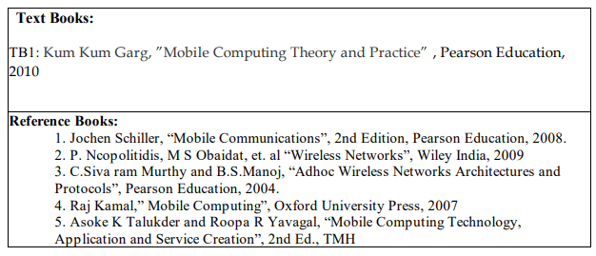
Reference Books

Slide 7
Mobile Computing - Overview
Mobile Computing is a technology that provides an environment that enables users to transmit data from one device to another device without the use of any physical link or cables.
Mobile Computing is a technology that can access and transmit data from any remote locations without being present there physically. It provides a vast coverage diameter for communication. It is one of the fastest and most reliable sectors of the computing technology field.

Slide 8
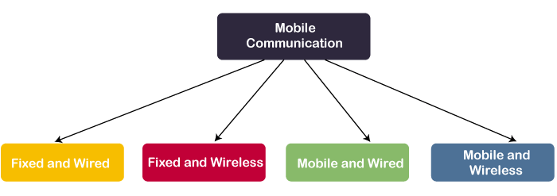
Eg: Desktop Computer.
Eg: Communication Towers, Wi-fi routers
Eg: Laptops.
Eg: WiFi Dongle

Slide 9
The main concept involves −
Mobile communication - These would include devices such as protocols, services, bandwidth, and portals necessary to facilitate and support the stated services.
Mobile hardware- This includes mobile devices or device components that receive or access the service of mobility. They would range from portable laptops, smartphones, tablet Pc's, Personal Digital Assistants
Mobile software- This is the program that runs on the mobile hardware. It deals with the characteristics and requirements of mobile applications. (This is the engine of the mobile device.)

Slide 10
Applications of Mobile Computing
Web or Internet access.
Global Position System (GPS).
Emergency services.
Entertainment services.
Educational services.

Slide 11
Unit 1
Contents:
Introduction:
Introduction to mobile computing,
Application examples
Mobile computing architecture
Mobile devices.

Slide 12
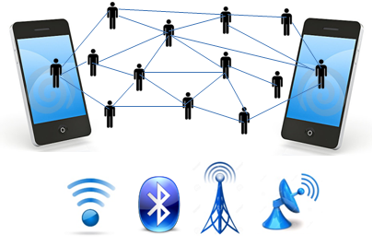
Mobile Computing
A technology that allows transmission of data, voice and video via a computer or any other wireless enabled device without having to be connected to a fixed physical link.

Slide 13
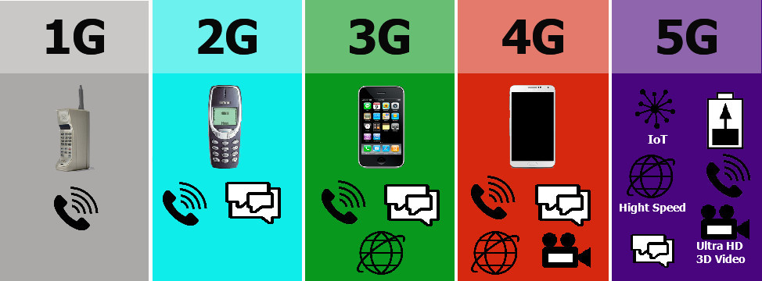
Evolution of Mobile Computing
The mobile wireless Generation (G) generally refers to a change in the nature of the system, speed, technology, frequency, data capacity, latency.

Slide 14
Evolution of Mobile Computing
First Generation: 1 G
Introduced in 1980 and continued till 1990
Used for voice communication based on a technology called AMPS( Advanced Mobile Phone System)
AMPS system uses FDMA
Speed 2.4 kbps

Slide 15
Evolution of Mobile Computing
First Generation: 1 G
Allows voice calls in 1 country
Use analog signal.
Poor voice quality
Poor battery life
Limited capacity and poor handoff reliability

Slide 16
Evolution of Mobile Computing
Second Generation: 2 G
It uses digital signals for voice transmission
Provides services to deliver text and picture message at low speed (in kbps).
It implemented both GSM and CDMA
Uses both packet switched and circuit switched to provide data rate upto 144 Kbps

Slide 17
Evolution of Mobile Computing
Second Generation: 2 G
SMS, internal roaming , conference calls, call hold and billing based on services e.g. charges based on long distance calls and real time billing.
The max speed of 2G with General Packet Radio Service ( GPRS ) is 50 Kbps or 1 Mbps
Before making the major leap from 2G to 3G wireless networks, the lesser-known 2.5G and 2.75G was an interim standard that bridged the gap.

Slide 18
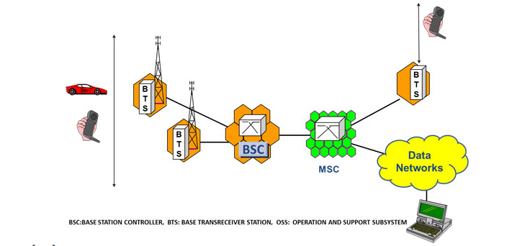
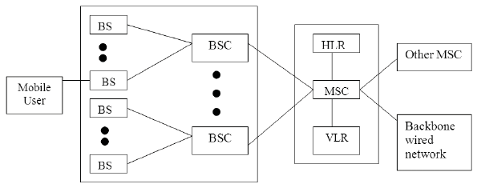
Cellular Architecture

Slide 19
Communication Flow
Call Request:
A mobile device initiates a call.
The Base Station sends the request to the BSC, which forwards it to the MSC.
The MSC validates the request, authenticates the user, and establishes the call.

Slide 20
Communication Flow
Handover:
A user moves to a new cell.
The BSC detects signal strength changes and requests the MSC to coordinate the handover if it involves another BSC.
The MSC informs the new BSC to allocate resources, ensuring seamless service.

Slide 21
Evolution of Mobile Computing
Second Generation: 2.5 G
Provides phone calls
Send/receive e-mail messages
Web browsing
Speed : 64-144 kbps
Camera phones

Slide 22
Evolution of Mobile Computing
Third Generation: 3 G
Web browsing, email, video downloading, picture sharing and other Smartphone technology were introduced in the third generation
3G is based on GSM and was launched in 2000.
Speed 2 Mbps
Increased bandwidth and data transfer rates to accommodate web-based applications and audio and video files

Slide 23
Evolution of Mobile Computing
Fourth Generation: 4 G
4G offers a downloading speed of 100Mbps.
Capable of provide 10Mbps-1Gbps speed
High quality streaming video
Combination of Wi-Fi and Wi-Max
High security

Slide 24
Evolution of Mobile Computing
Higher Data Rates: 5G is designed to provide significantly faster data rates compared to 4G. It aims to achieve peak data rates of up to 20 Gbps, enabling faster download and upload speeds.
Low Latency: 5G networks aim to reduce latency, the time it takes for data to travel from the source to the destination. Low latency is crucial for applications like real-time gaming, augmented reality (AR), and virtual reality (VR).

Slide 25
Evolution of Mobile Computing
Increased Network Capacity: 5G networks are designed to handle a much larger number of connected devices simultaneously. This is essential for the growing number of IoT (Internet of Things) devices and the increasing demand for connectivity.
Improved Reliability: 5G is expected to offer improved network reliability and stability. This is achieved through technologies like network slicing, which allows for the creation of virtualized, dedicated networks for specific use cases

Slide 26
Location dependent services
Location aware services
what services, e.g., printer, fax, phone, server etc. exist in the local environment
Follow-on services
automatic call-forwarding, transmission of the actual workspace to the current location
Information services
Push “: e.g., current special offers in the supermarket
Pull“: e.g., where can I get my favorite pastry?

Slide 27
Location dependent services
Support services
caches, intermediate results, state information etc. follow the mobile device through the fixed network
Privacy
who should gain knowledge about the location

Slide 28
Mobile Computing Architecture
Three tier architecture
User interface\Presentation tier
Application Tier
Data Tier

Slide 29
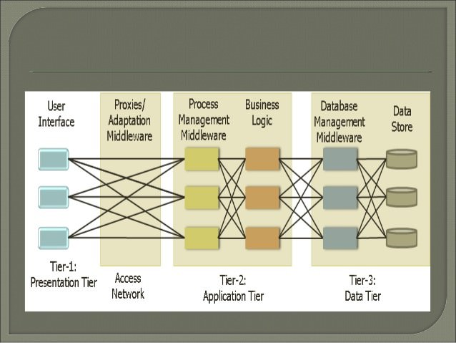
Mobile Computing Architecture
This is a comprehensive design showing how mobile applications are structured to handle everything from user interactions to data storage.

Slide 30
First Layer - Presentation Tier (Tier-1):
This is where users actually interact with their mobile apps
Contains all the visual elements users see and touch
Examples: buttons, forms, menus, screens on your mobile app
Multiple boxes show it can handle many users simultaneously

Slide 31
Connection Layer - Access Network:
Works like a smart traffic controller
Handles how your phone connects to the main system
Adapts data for different devices and network conditions
The crossing lines show it can route traffic efficiently
If one path fails, it can use another (like having multiple roads to reach the same destination)

Slide 32
Middle Layer - Application Tier (Tier-2):
Contains two crucial parts:
Process Management: Organizes all the tasks and workflows (Example: When you order food, it manages the steps from selection to payment)
Business Logic: Contains all the rules and decision-making (Example: Calculating prices, applying discounts, checking if items are in stock)

Slide 33
Back Layer - Data Tier (Tier-3):
Two important components:
Database Management: Organizes how data is stored and retrieved (Like a librarian organizing and finding books)
Data Store: Where all information is actually kept (Like the library's bookshelves)

Slide 34
Design Adaptability
Can handle more users by adding more capacity at any layer
If one part has problems, others can still work
Easy to update or fix specific parts without touching others
Adapts well to different types of mobile devices and networks
Think of it like a restaurant:
Front Tier: The dining area where customers interact
Access Network: The waiters taking orders to the kitchen
Application Tier: The kitchen where food is prepared according to recipes
Data Tier: The pantry and refrigerators where ingredients are stored

Slide 35
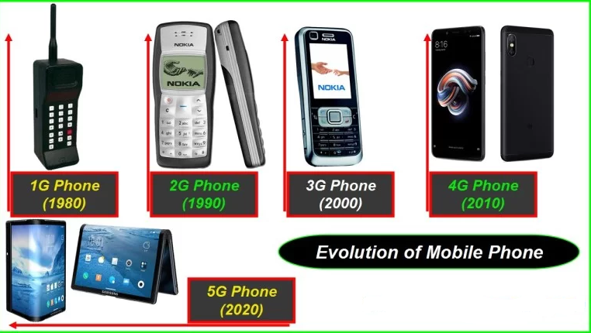
Mobile Devices

Slide 36
Thank You

